Slide 1
The Relational Model

Slide 2
Data Model
A Data Model is a notation for describing data or information. Consists of three parts:
  Structure of data (e.g. arrays, structs)
    Conceptual model: In databases, structures are at a higher level.
  Operations on data (Modifications and Queries)
    Limited Operations: Ease of programmers and efficiency of database.
  Constraints on data (what the data can be)
Two Important Data Models Today
  The Relational Model
  The Semistructured-Data Model
    XML and related standards

Slide 3
The Relational Model
Simple: Built around a single concept for modeling data: the relation or table.
  A relational database is a collection of relations.
  Each relation is a table with rows and columns.
Supports high-level programming language (SQL).
  Limited but very useful set of operations
  Enables programmers to express their wishes at a very high level
Has an elegant mathematical design theory.
Most current DBMS are relational.

Slide 4
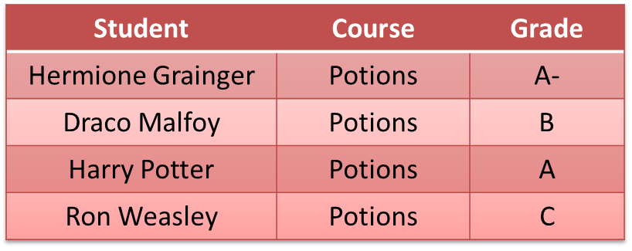
Relations
A relation is a two-dimensional table:
  Relation ≈ table.
  Attribute ≈ column name.
  Tuple ≈ row (not the header row).
Database ≈ collection of relations.
A relation has two parts:
  Schema defines column heads of the table (attributes).
  Instance contains the data rows (tuples, rows, or records) of the table.

Slide 5

Schema
CoursesTaken :
The schema of a relation is the name of the relation followed by a parenthesized list of attributes.
CoursesTaken(Student, Course, Grade)
A design in a relational model consists of a set of schemas.
Such a set of schemas is called a relational database schema.

Slide 6
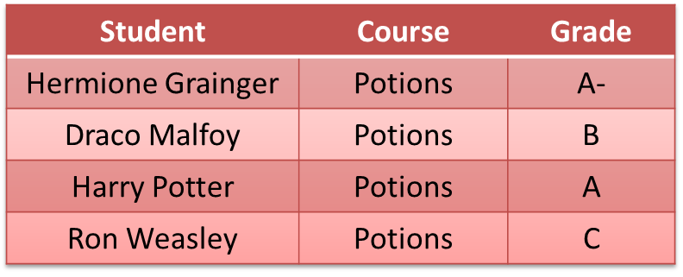
Equivalent Representations of a Relation
CoursesTaken :
CoursesTaken(Student, Course, Grade)
Relation is a set of tuples and not a list of tuples.
  Order in which we present the tuples does not matter.
The attributes in a schema are also a set (not a list).
  Schema is the same irrespective of order of attributes.
  CoursesTaken(Student, Grade, Course)
  We specify a “standard” order when we introduce a schema.
How many equivalent representations are there for a relation with m attributes and n tuples?
m! n!

Slide 7
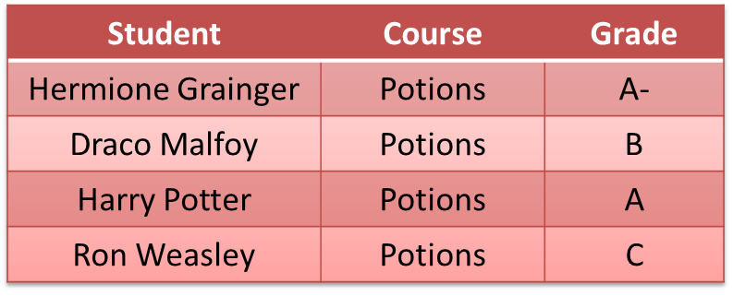
Degree and Cardinality
CoursesTaken :
Degree is the number of fields/attributes in schema (=3 in the table above)
Cardinality is the number of tuples in relation (=4 in the table above)

Slide 8
Example
Create a database for managing class enrollments in a single semester. You should keep track of all students (their names, Ids, and addresses) and professors (name, Id, department). Do not record the address of professors but keep track of their ages. Maintain records of courses also. Like what classroom is assigned to a course, what is the current enrollment, and which department offers it. At most one professor teaches each course. Each student evaluates the professor teaching the course. Note that all course offerings in the semester are unique, i.e. course names and numbers do not overlap. A course can have ≥ 0 pre-requisites, excluding itself. A student enrolled in a course must have enrolled in all its pre-requisites. Each student receives a grade in each course. The departments are also unique, and can have at most one chairperson (or dept. head). A chairperson is not allowed to head two or more departments.

Slide 9
Example
Create a database for managing class enrollments in a single semester. You should keep track of all students (their names, Ids, and addresses) and professors (name, Id, department). Do not record the address of professors but keep track of their ages. Maintain records of courses also. Like what classroom is assigned to a course, what is the current enrollment, and which department offers it. At most one professor teaches each course. Each student evaluates the professor teaching the course. Note that all course offerings in the semester are unique, i.e. course names and numbers do not overlap. A course can have ≥ 0 pre-requisites, excluding itself. A student enrolled in a course must have enrolled in all its pre-requisites. Each student receives a grade in each course. The departments are also unique, and can have at most one chairperson (or dept. head). A chairperson is not allowed to head two or more departments.

Slide 10
Relational Design for the Example
Students (PID: string, Name: string, Address: string)
Professors (PID: string, Name: string, Office: string, Age: integer, DepartmentName: string)
Courses (Number: integer, DeptName: string, CourseName: string, Classroom: string, Enrollment: integer)
Teach (ProfessorPID: string, Number: integer, DeptName: string)
Take (StudentPID: string, Number: integer, DeptName: string, Grade: string, ProfessorEvaluation: integer)
Departments (Name: string, ChairmanPID: string)
PreReq (Number: integer, DeptName: string, PreReqNumber: integer, PreReqDeptName: string)

Slide 11
Issues to Consider in the Design
Can we merge Courses and Teach since each professor teaches at most one course?
Do we need a separate relation to store evaluations?
How can we handle pre-requisites that are “or”s, e.g., you can take CS 4604 if you have taken either CS 2604 or CS 2606?
How do we generalize this schema to handle data over more than one semester?
What modifications does the schema need if more than one professor can teach a course?

Slide 12
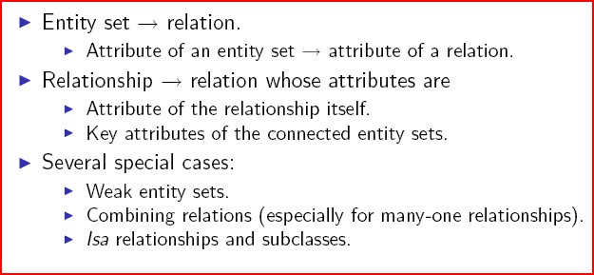
From E/R Diagrams to Relations

Slide 13
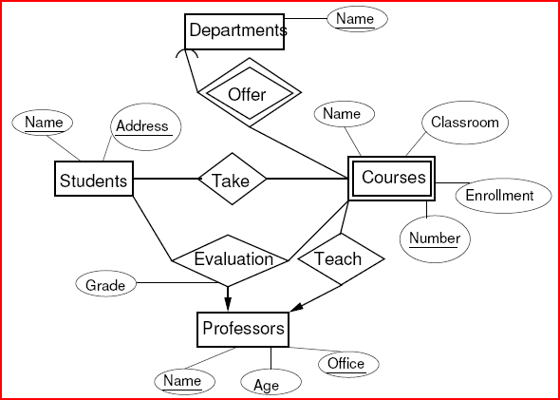
Schemas for Non-Weak Entity Sets
For each entity set, create a relation with the same name and with the same set of attributes.
Students(Name, Address)
Professors(Name, Office, Age)
Departments(Name)

Slide 14
Schemas for Weak Entity Sets
For each weak entity set W, create a relation with the same name whose attributes are
  Attributes of W and
  Key attributes of the other entity sets that help form the key for W.
Courses(Number, DepartmentName, CourseName, Classroom, Enrollment)

Slide 15
Schemas for Non-Supporting Relationships
For each relationship, create a relation with the same name whose attributes are
  Attributes of the relationship itself.
  Key attributes of the connected entity sets (even if they are weak).

Slide 16
Schemas for Non-Supporting Relationships
Take(StudentName, Address, Number, DepartmentName)
Teach(ProfessorName, Office, Number, DepartmentName)
Evaluation(StudentName, Address, ProfessorName, Office, Number, DepartmentName, Grade)

Slide 17
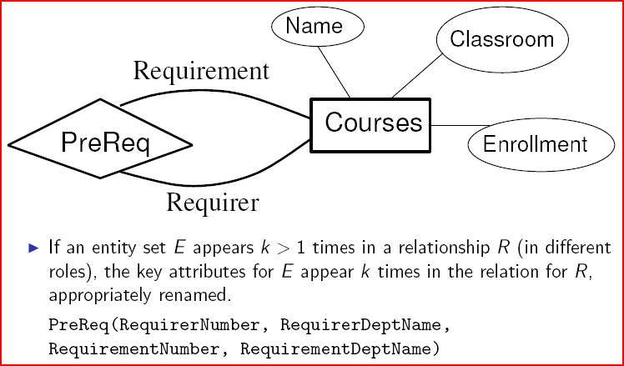
Roles in Relationships

Slide 18
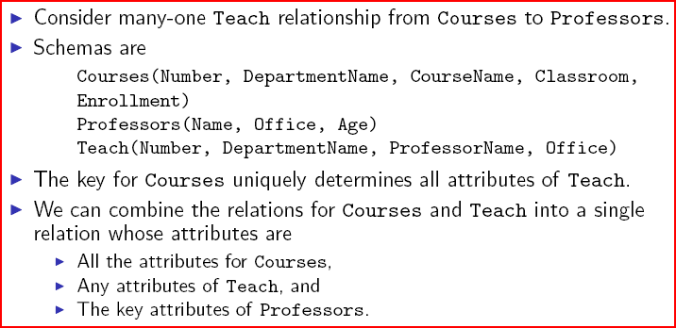
Combining Relations

Slide 19
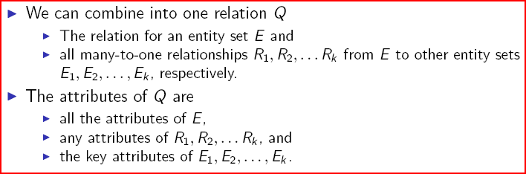
Rules for Combining Relations

Slide 20
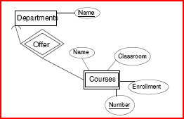
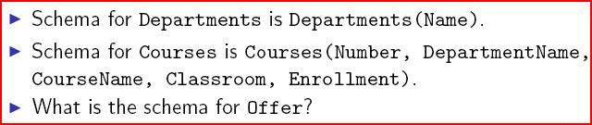
Supporting Relationships

Slide 21
Supporting Relationships
Offer(Name, Number, DepartmentName).
But Name and DepartmentName are identical, so the schema for Offer is Offer(Number, DepartmentName).
The schema for Offer is a subset of the schema for the weak entity set, so we can dispense with the relation for Offer.

